Slide 1
Final Project
By Cameron Pick

Slide 2
Background
My topic is credit card customer demographics. I want to explore what factors play into a customer leaving a credit card company, called attrition, or staying with the company. Therefore, some statistical questions I would like to explore are:
Is there a relationship between demographic variables and a customer leaving?
Is there a relationship between the company’s product variables and a customer leaving?
Which one has the great effect, (1) or (2), and what is the correlation between those variables and customer attrition?
Lastly, can I predict when a customer will leave based on variables from (1) or (2)?

Slide 3
Background
For my project, I’ll be using the dataset BankChurners.csv to perform my project. I found my dataset from Kaggle by this link: https://www.kaggle.com/sakshigoyal7/credit-card-customers. Any goal of a credit card company is to make money. Doing analysis on data about a former customer can answer questions on how a company can better keep customers. If a company can predict when a customer will leave, they could offer products or something to keep the customer, for example.

Slide 4
Background
Attrition-Dependent variable
Age
Gender
How many dependents
Education
Marital Status
Income
Card Category
Months on book
Total number of products held by the customer
Number of months inactive

Slide 5
Background
Number of contacts count
Credit limit
Total revolving balance
Average open to buy(The difference between the credit limit assigned to a cardholder account and the present balance on the account)
Change in Transaction Amount (Q4 over Q1)
Total Transaction Amount (Last 12 months)
Total Transaction Count (Last 12 months)
Change in Transaction Count (Q4 over Q1)
Average utilization ratio
Naive Bayes 1
Naive Bayes 2

Slide 6
Variable Selection
I read the dataset, called project.
This is unbalanced dataset, meaning there are way more customers staying than leaving, which is expected since this is what a company should have.
This problem is addressed later in analysis.
I rename columns for simplicity
I created a new dataset, data1, dropping the Bayes information and Clientnum
I checked for any duplicate and null values
Then, I checked for multicollinearity. This led to dropping by creating data2:
‘Age', 'Months_on_book', 'Total_Revolving_Bal','Avg_Utilization_Ratio', 'Total_Trans_Amt', 'Total_Trans_Ct

Slide 7
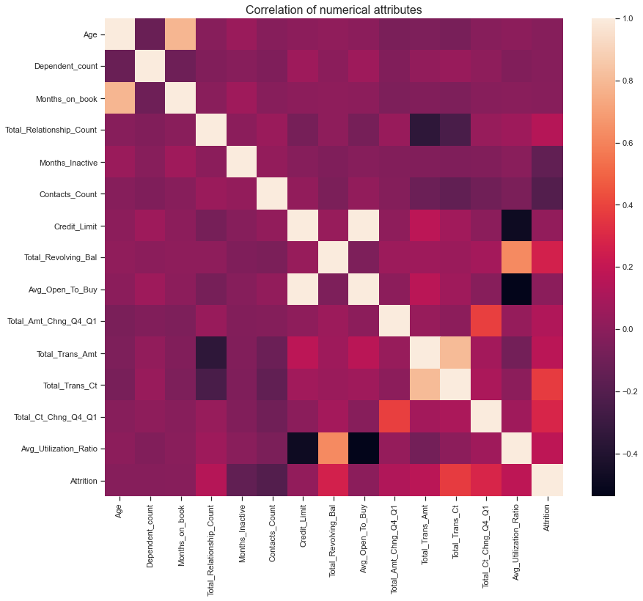
Heat map for multicollinearity

Slide 8
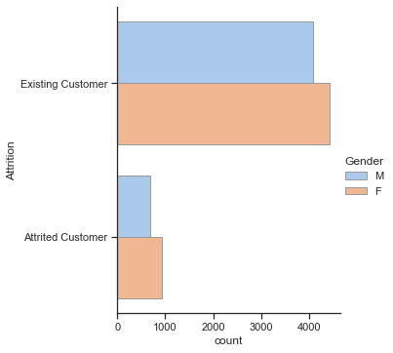
Demographic variables
This led to the first question of my statistical questions.
Is there a relationship between demographic variables and a customer leaving?
Let’s look at bar charts.
Gender vs staying/leaving
Not a significant difference between gender.

Slide 9
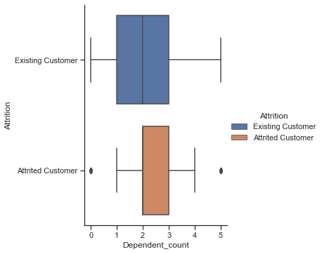
Demographics
The next variable, dependents and leaving/staying.
Not much of a difference.

Slide 10
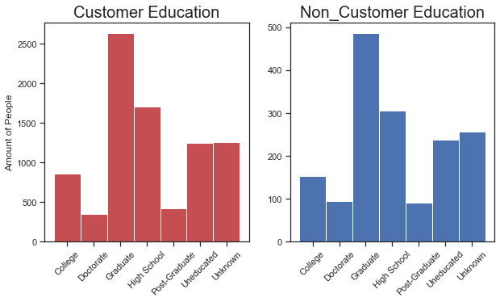
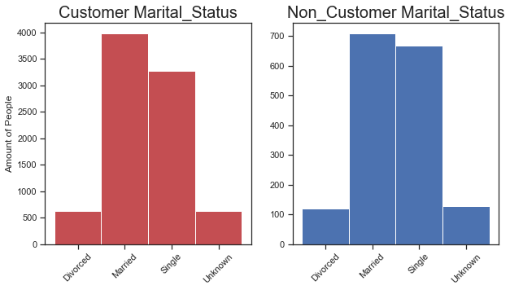
Demographics
Education and Martial Status. Again, not much of difference.

Slide 11
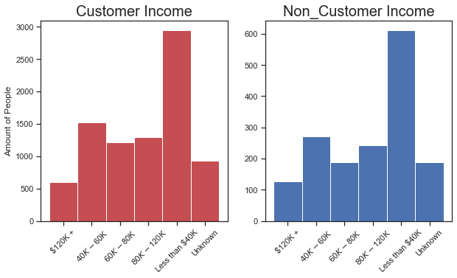
Demographics
Lastly, Income. Same as others. I conclude that there is not a relationship between demographic variables and a customer leaving.
So, I safely drop.'Gender', 'Dependent_count', 'Education', 'Marital_Status', 'Income’ by creating data3

Slide 12
Post demographics
Now, I convert any categorial variables into numerical using OrdinalEncoder()
These are: ‘Attrition', 'Card_Category’ and turn them into ‘Attrition1', 'Card_Category1’ and add it to data3
Then, I drop ‘Attrition', 'Card_Category’ by creating data4, which is the final and clean dataset.

Slide 13
Description of Variables
The variables left are:
Total Relationship Count-how many products with credit card company(CCC)
Months Inactive- how many months inactive with CCC
Contacts count- how many times contact by CCC
Credit Limit-how much to spend
Average open to buy-The difference between the credit limit assigned to a cardholder account and the present balance on the account
Change in Transaction Amount (Q4 over Q1)
Total Transaction Count (Last 12 months)
Card Category

Slide 14
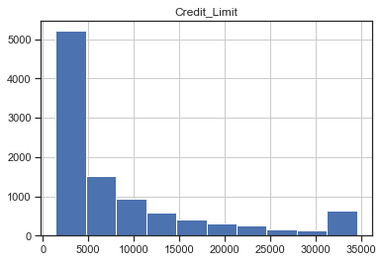
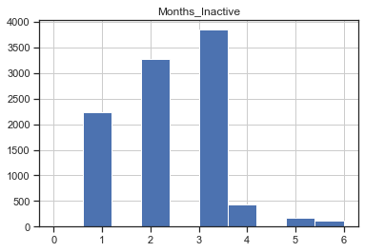
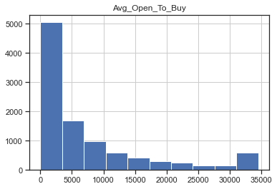
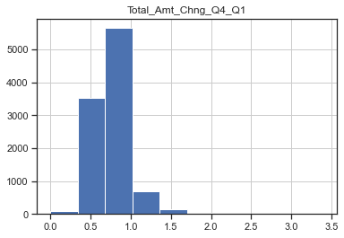
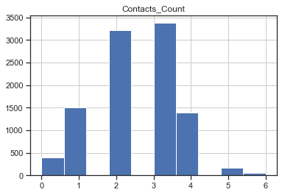
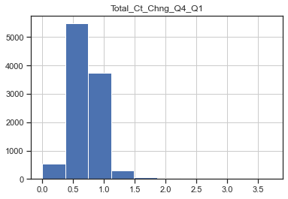
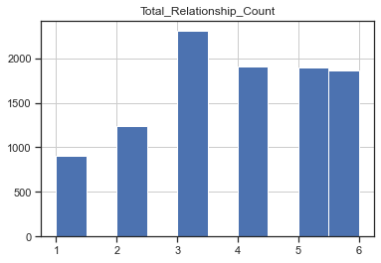
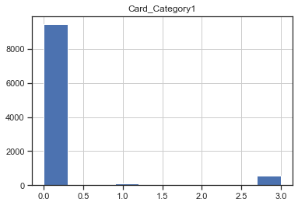
Histograms

Slide 15
Interpretations
I don’t really see outliers, more skewed data.
I intend to leave the data alone

Slide 16
DESCRIPTIVE STATISTICS
Total_Relationship_Count Months_Inactive
max 6.000000 6.000000
mean NaN 2.341167
median 4.000000 2.000000
min 1.000000 0.000000
skew -0.162452 NaN

Slide 17
DESCRIPTIVE STATISTICS
Contacts_Count Credit_Limit
min 0.000000 1438.300000
max 6.000000 34516.000000
median 2.000000 4549.000000
mean 2.455317 8631.953698

Slide 18
DESCRIPTIVE STATISTICS
Avg_Open_To_Buy Total_Amt_Chng_Q4_Q1
min 3.000000 0.000000
max 34516.000000 3.397000
median 3474.000000 0.736000
mean 7469.139637 0.759941

Slide 19
DESCRIPTIVE STATISTICS
Total_Ct_Chng_Q4_Q1 Card_Category1 Attrition1
min 0.000000 0.000000 0.00000
max 3.714000 3.000000 1.00000
median 0.702000 0.000000 1.00000
mean 0.712222 0.179816 0.83934

Slide 20
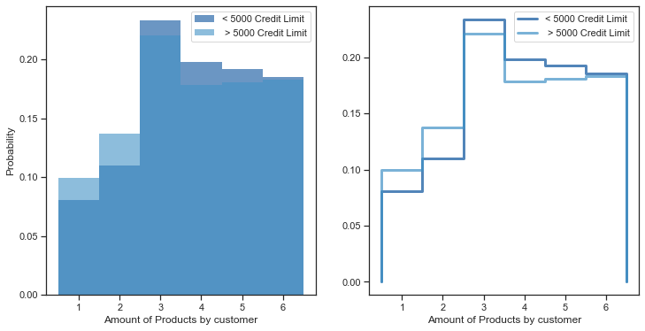
PMF
First, I separated data2 by credit limit by following: < 5000 and > 5000
less_5000 = data2[data2["Credit_Limit"] < 5000]
more_5000 = data2[data2["Credit_Limit"] > 5000]
Then, from the above dataset, I analyzed how many products a customer has separated by credit limit. The results are to the right.

Slide 21
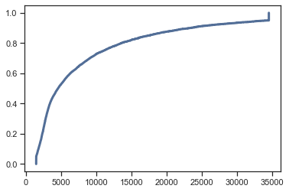
CDF
I creating a CDF of credit limit using data4.
For analysis, probability of selecting someone with a $5000 limit is around .4
It doesn’t say anything about the statistical questions I am trying to answer.

Slide 22
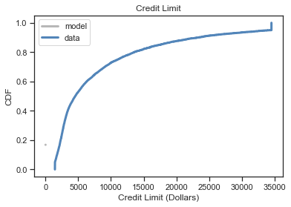
Analytic Distribution
I created CDF of credit limit.
I used what the model said vs data. It is almost perfect indicating normal data.
It doesn’t say anything about the statistical questions I am trying to answer.
It does indicate normal data, good for regression analysis.

Slide 23
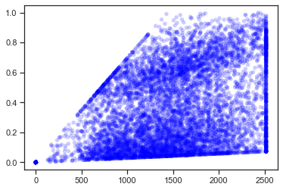
ScatterPlots
Here is a scatterplot of total revolving balance and average utilization ratio. These aren’t part of the final dataset.
Correlation is 0.62
Spearman correlation is 0.71
Indication of correlation between the variables.
This relationship could make sense since a higher total revolving balance would result in a higher utilization ratio.

Slide 24
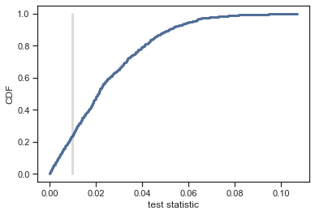
Hypothesis Testing
I created two new datasets, Male and Female, using data2.
I wanted to test to see if there was a difference in means of amount of products by customer between males and females.
P-value is 0.757
This indicates no statistical difference between males and females.

Slide 25
Linear Regression analysis
This brings up a the second question: Is there a relationship between the company’s product variables and a customer leaving? These are the credit card company’s numbers such as amount of products a customer has or their credit limit.
Intercept 0.564 (2.76e-212)
Total_Relationship_Count 0.035 (3.37e-61)
Months_Inactive -0.0463 (2.77e-46)
Contacts_Count -0.0579 (1.68e-83)
Credit_Limit 0.000102 (5.54e-137)
Avg_Open_To_Buy -0.000101 (1.85e-134)
Total_Ct_Chng_Q4_Q1 0.374 (1.9e-156)
Card_Category1 -0.000595 (0.912)
R^2 0.207

Slide 26
Linear Regression
Some are significant, some aren’t. Let’s do some correlation.
thinkstats2.Corr(data4.Attrition1,data4.Total_Relationship_Count)
Out[121]: 0.15000522801913746
thinkstats2.Corr(data4.Attrition1,data4.Months_Inactive)
Out[122]: -0.15244880632692506
thinkstats2.Corr(data4.Attrition1,data4.Contacts_Count)
Out[123]: -0.20449050998160448
thinkstats2.Corr(data4.Attrition1,data4.Credit_Limit)
Out[124]: 0.023872994836161544

Slide 27
Correlation
thinkstats2.Corr(data4.Attrition1,data4.Avg_Open_To_Buy)
Out[125]: 0.00028507749393780115
thinkstats2.Corr(data4.Attrition1,data4.Total_Amt_Chng_Q4_Q1)
Out[126]: 0.13106284781447014
thinkstats2.Corr(data4.Attrition1,data4.Total_Ct_Chng_Q4_Q1)
Out[127]: 0.29005400688089117
thinkstats2.Corr(data4.Attrition1,data4.Card_Category1)
Out[128]: 0.006038132069122878

Slide 28
Correlation
As highlighted, there is some negative and positive correlation but not large.
As a result, I conclude that there is some relationship between company’s product variables and a customer leaving. This isn’t a strong relationship.
The R-squared is only about 21%, there still is a lot unexplained.

Slide 29
Further EDA
I moved to R, since Spyder did not have a built in package for unbalanced data and EDA.
Moving to R, I created a training and test dataset using data4.
I used SMOTE method to handle the unbalanced datset.
SMOTE stands for Synthetic Minority Oversampling Technique.
This method involves addressing imbalanced datasets by oversampling the minority class. The simplest approach involves duplicating examples in the minority class, although these examples don’t add any new information to the model. R has a built in function for this.

Slide 30
SMOTE
I created a balanced dataset using SMOTE function.
Next, I created a logistic regression model using the balanced dataset.
Logistic works since attrition was “Existing Customer” and “Attrited Customer” and then was converted into binary.
I ran through the predict functions on both training and test datasets using the balanced model
I created the confusion matrix and calculated the accuracy
0.8774194 was the accuracy.
The previous regression model didn’t account for the unbalanced dataset.
Logistic regression was better fit.

Slide 31
Conclusions-Statistical questions
Is there a relationship between demographic variables and a customer leaving?
Is there a relationship between the company’s product variables and a customer leaving?
Which one has the great effect, (1) or (2), and what is the correlation between those variables and customer attrition?
Lastly, can I predict when a customer will leave based on variables from (1) or (2)?

Slide 32
Conclusion
I answered 1 and 2 already. Demographics are not significant. The others are important. Answering question 3, we know the other variables are important.
Yes, I can predict, with around 87% accuracy, if a customer will leave or stay based on the final dataset variables.
Implications are the company could decide which customers are more likely to leave and offer deals or something to keep them.

